Slide 1
Introduction to Neural Networks
2019. 07. 22
발표자: 김영기
Fei-Fei Li & Justin Johnson & Serena Yeung April 13, 2017

Slide 2
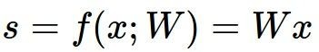
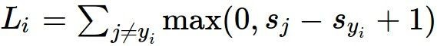
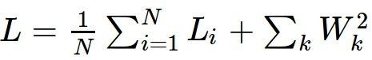
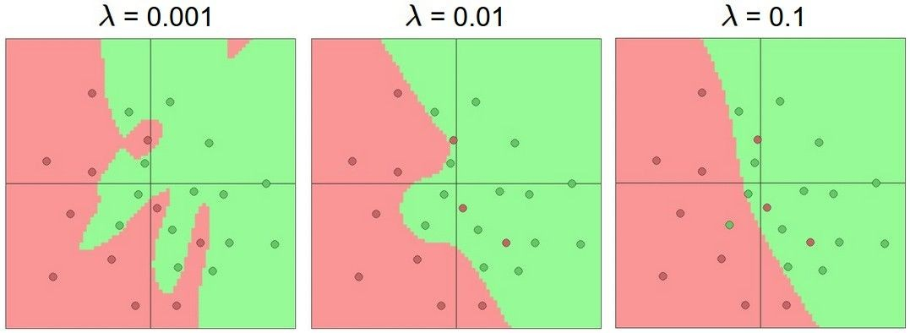
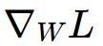
Where we are...
scores function
SVM loss / Softmax
data loss + regularization
Overfitting 방지
want

Slide 3

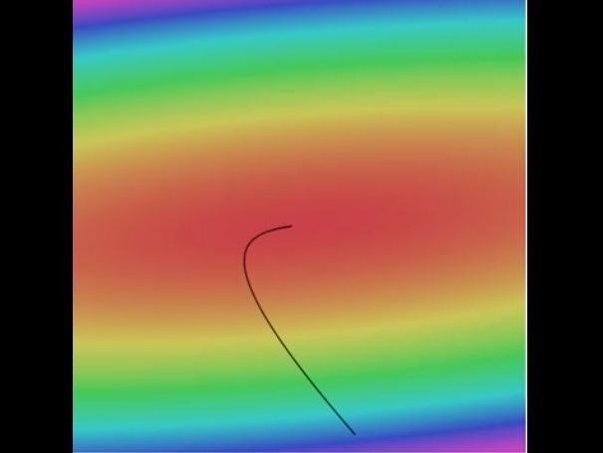

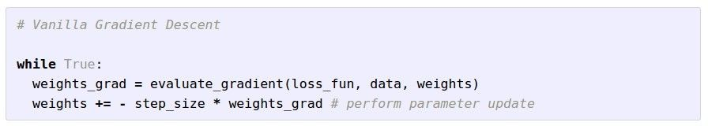
Optimization
Loss를 줄이는 hyperparameter를 찾아가는 과정
Landscape image is CC0 1.0 public domain Walking man image is CC0 1.0 public domain

Slide 4
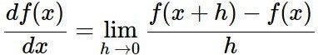
Gradient descent
Numerical gradient: slow :(, approximate :(, easy to write :)
Analytic gradient: fast :), exact :), error-prone :(

Slide 5
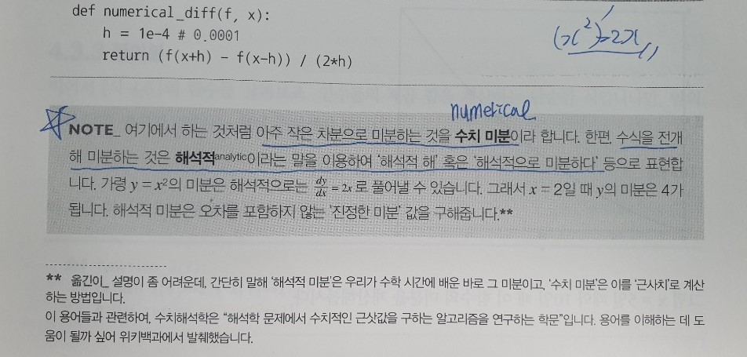
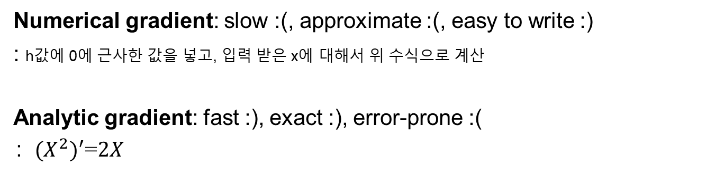
Gradient descent
Numerical gradient: slow :(, approximate :(, easy to write :)
: h값에 0에 근사한 값을 넣고, 입력 받은 x에 대해서 위 수식으로 계산
Analytic gradient: fast :), exact :), error-prone :(
: ${{(X}^{2})}^{′}$=$2X$

Slide 6
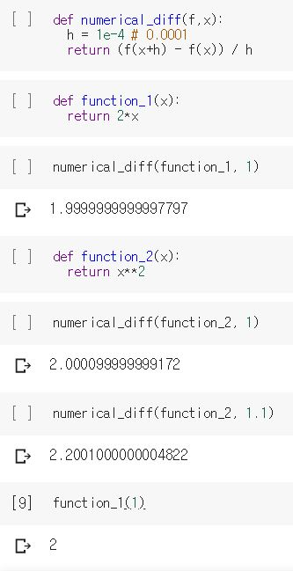
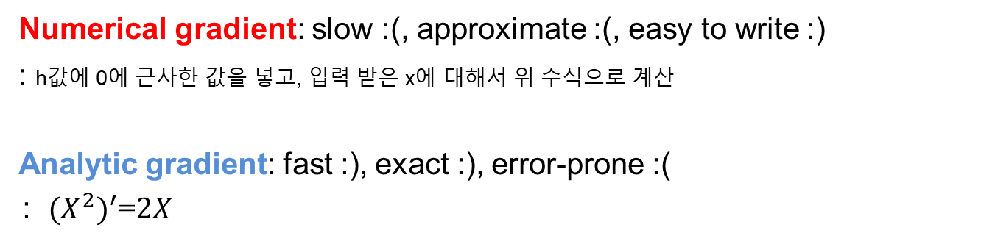
Gradient descent
Numerical gradient: slow :(, approximate :(, easy to write :)
: h값에 0에 근사한 값을 넣고, 입력 받은 x에 대해서 위 수식으로 계산
Analytic gradient: fast :), exact :), error-prone :(
: ${{(X}^{2})}^{′}$=$2X$

Slide 7
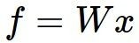
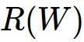
Computational graphs
x
*
s (scores)
hinge loss
+
L
W
R

Slide 8
Artificial Neural Networks

Slide 9
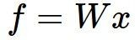
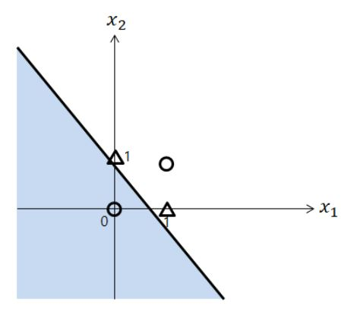

Neural networks: without the brain stuff
(Before) Linear score function:

Slide 10
Neural networks: without the brain stuff
(Before) Linear score function:

Slide 11
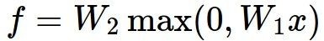
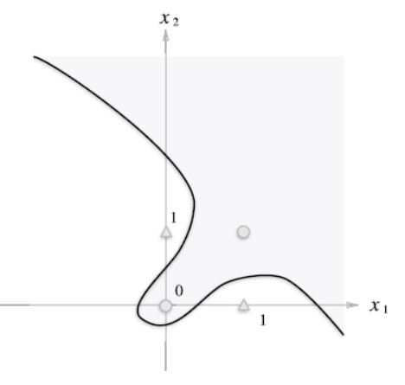
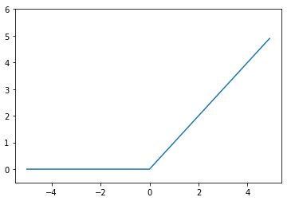
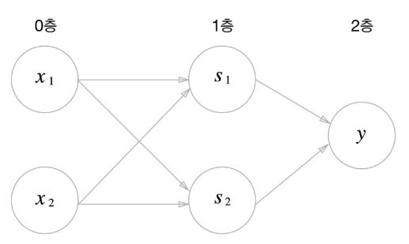
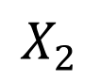
Neural networks: without the brain stuff
(Before) Linear score function: (Now) 2-layer Neural Network
$$X_{2}$$
ReLU

Slide 12
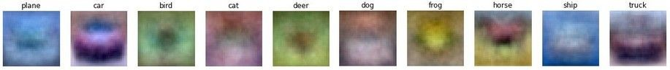
Neural networks: without the brain stuff
(Before) Linear score function: (Now) 2-layer Neural Network
x
h
W1
W2
s
3072
100
10
Hyperparameter

Slide 13
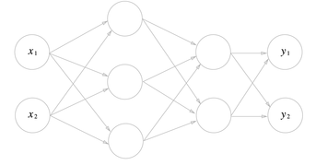
Neural networks: without the brain stuff
(Before) Linear score function: (Now) 2-layer Neural Network
or 3-layer Neural Network
Hidden Layer

Slide 14
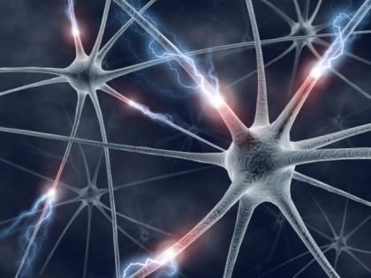
This image by Fotis Bobolas is licensed under CC-BY 2.0

Slide 15
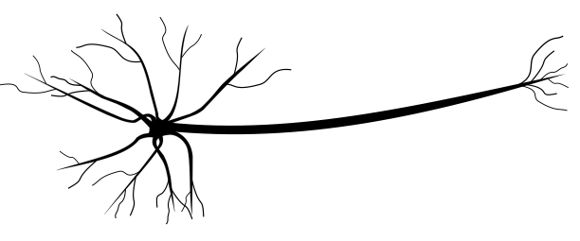
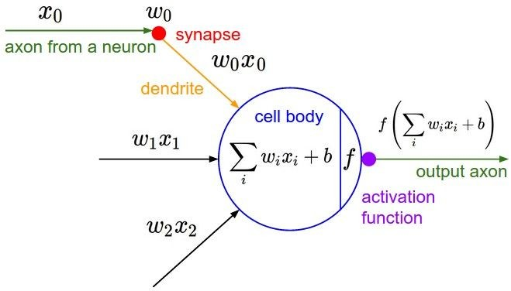
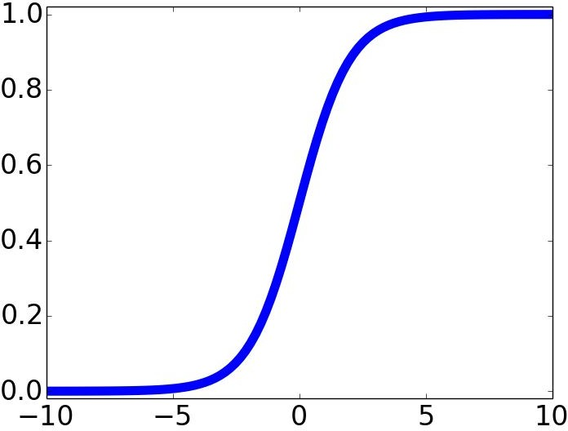
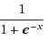
Impulses carried toward cell body
dendrite
presynaptic terminal
시냅스
axon
cell body
추상돌기
입력
Impulses carried away from cell body
수상돌기
This image by Felipe Perucho is licensed under CC-BY 3.0
sigmoid activation function

Slide 16
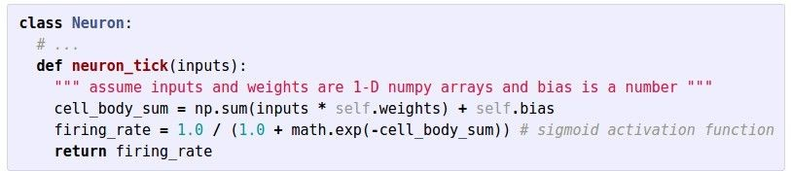
Impulses carried toward cell body
dendrite
presynaptic terminal
axon
cell body
Impulses carried away from cell body
This image by Felipe Perucho is licensed under CC-BY 3.0

Slide 17
Be very careful with your brain analogies!
Biological Neurons:
Many different types
Dendrites can perform complex non-linear computations
Synapses are not a single weight but a complex non-linear dynamical system
Rate code may not be adequate
[Dendritic Computation. London and Hausser]

Slide 18
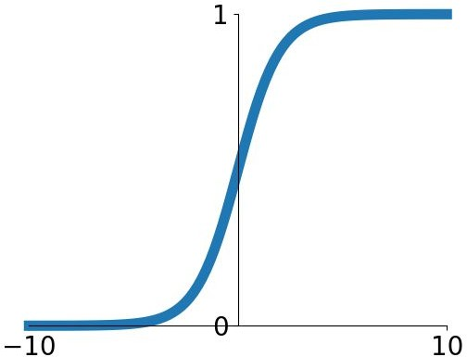
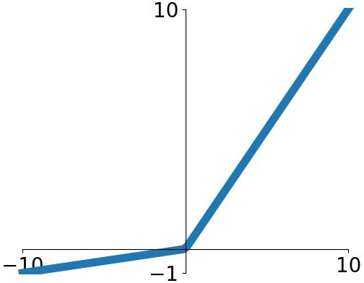
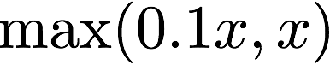
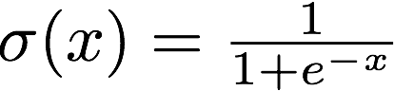
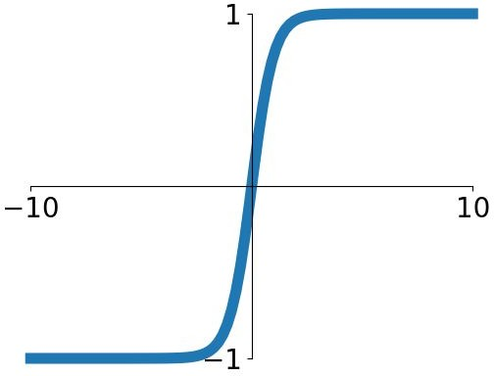
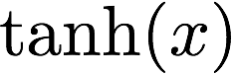
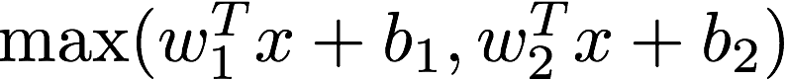
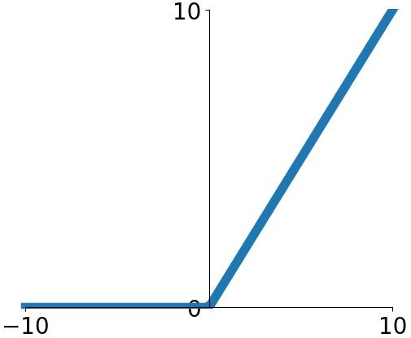
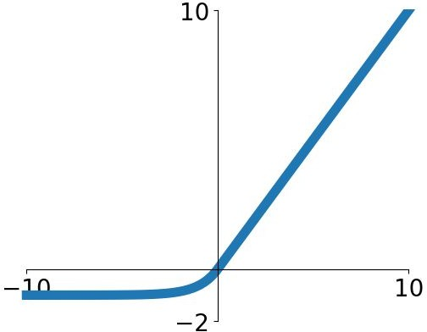
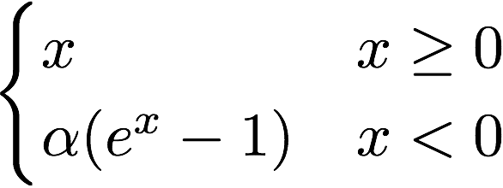
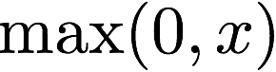
Activation functions
Sigmoid
tanh
Leaky ReLU
Maxout
ReLU
ELU

Slide 19
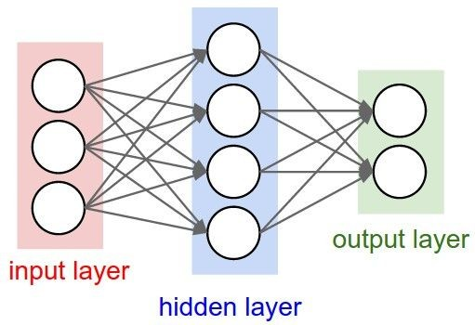
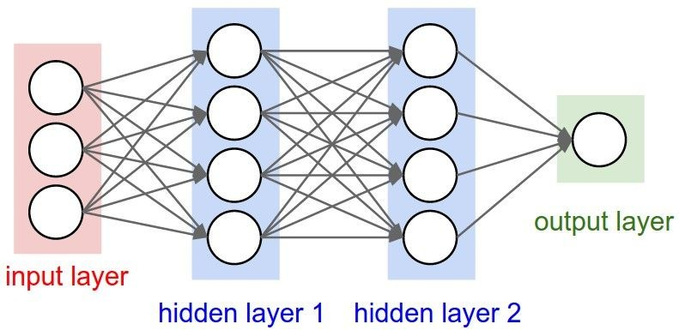
Neural networks: Architectures
“3-layer Neural Net”, or
“2-hidden-layer Neural Net”
“Fully-connected” layers
“2-layer Neural Net”, or
“1-hidden-layer Neural Net”

Slide 20
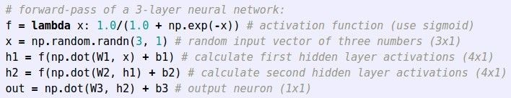
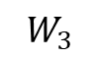
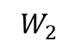
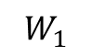
Example feed-forward computation of a neural network
$$W_{2}$$
$$W_{1}$$
$$W_{3}$$
Forward Pass
Forward Propagation
Loss

Slide 21
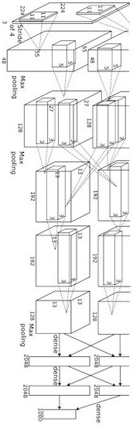
Convolutional network (AlexNet)
input image
weights loss
Figure copyright Alex Krizhevsky, Ilya Sutskever, and Geoffrey Hinton, 2012. Reproduced with permission.

Slide 22
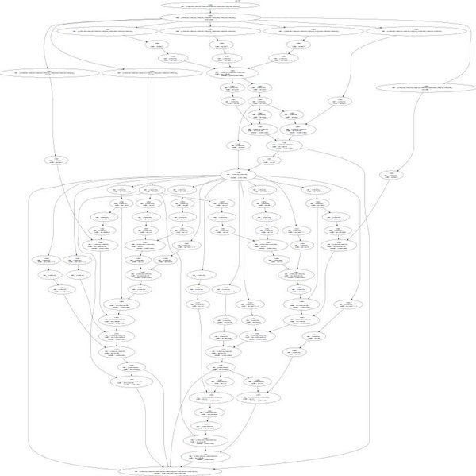
Neural Turing Machine
input image
loss
Figure reproduced with permission from a Twitter post by Andrej Karpathy.

Slide 23
Neural Turing Machine
Figure reproduced with permission from a Twitter post by Andrej Karpathy.
April 13, 2017
Fei-Fei Li & Justin Johnson & Serena Yeung

Slide 24
Backpropagation
Fei-Fei Li & Justin Johnson & Serena Yeung April 13, 2017

Slide 25
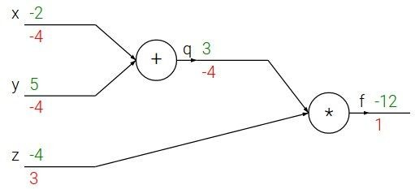
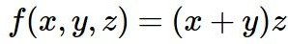
Backpropagation: a simple example
e.g. x = -2, y = 5, z = -4
Backward Pass
Backward Propagation
Backpropagation을 통해 input 값들이
Loss에 미치는 영향을 구할 수 있다.
각 input 값들이 output에 얼마만큼의 영향을 주는 가를 구하기 위해서 backprop를 함.
hyperparameter를 조정.

Slide 26





Backpropagation: a simple example
e.g. x = -2, y = 5, z = -4
Analytic gradient
Numerical gradient
Want:

Slide 27

Backpropagation: a simple example
e.g. x = -2, y = 5, z = -4
Want:

Slide 28

Backpropagation: a simple example
e.g. x = -2, y = 5, z = -4
Want:

Slide 29

Backpropagation: a simple example
e.g. x = -2, y = 5, z = -4
Want:

Slide 30



Backpropagation: a simple example
e.g. x = -2, y = 5, z = -4
Chain rule:
Want:

Slide 31
Backpropagation: a simple example
e.g. x = -2, y = 5, z = -4
Chain rule:
Want:

Slide 32

Backpropagation: a simple example
e.g. x = -2, y = 5, z = -4
Chain rule:
Want:

Slide 33


f

Slide 34


f
“local gradient”

Slide 35

f
“local gradient”
gradients

Slide 36

f
“local gradient”
gradients

Slide 37

f
“local gradient”
gradients

Slide 38
f
“local gradient”
gradients

Slide 39




Another example:
Sigmoid function

Slide 40


Another example:

Slide 41
Another example:

Slide 42

Another example:

Slide 43
Another example:

Slide 44

Another example:

Slide 45
Another example:

Slide 46

Another example:

Slide 47
Another example:

Slide 48
Another example:
(-1) * (-0.20) = 0.20

Slide 49
Another example:

Slide 50
Another example:
[local gradient] x [upstream gradient] [1] x [0.2] = 0.2
[1] x [0.2] = 0.2 (both inputs!)

Slide 51
Another example:
Chain rule:

Slide 52

Another example:
[local gradient] x [upstream gradient] x0: [2] x [0.2] = 0.4
w0: [-1] x [0.2] = -0.2

Slide 53


sigmoid function
sigmoid gate

Slide 54
sigmoid function
sigmoid gate
(0.73) * (1 - 0.73) = 0.2

Slide 55

Patterns in backward flow
add gate: gradient distributor
mul gate: gradient switcher
max gate: gradient router

Slide 56
Gradients add at branches
+

Slide 57


Gradients for vectorized code
(x,y,z are now vectors)
This is now the
Jacobian matrix (derivative of each element of z w.r.t. each element of x)
“local gradient”
f
gradients
https://m.blog.naver.com/PostView.nhn?blogId=jinohpark79&logNo=110190680093&proxyReferer=https%3A%2F%2Fwww.google.com%2F

Slide 58

Vectorized operations
f(x) = max(0,x) (elementwise)
Jacobian matrix
4096-d
input vector
Q: what is the size of the Jacobian matrix?
4096-d
output vector

Slide 59
Vectorized operations
f(x) = max(0,x) (elementwise)
Jacobian matrix
4096-d
input vector
Q: what is the size of the Jacobian matrix? [4096 x 4096!]
4096-d
output vector

Slide 60
Vectorized operations
f(x) = max(0,x) (elementwise)
4096-d
input vector
Q: what is the size of the Jacobian matrix? [4096 x 4096!]
4096-d
output vector
in practice we process an entire minibatch (e.g. 100) of examples at one time:
i.e. Jacobian would technically be a [409,600 x 409,600] matrix :\

Slide 61
A vectorized example:

Slide 62
A vectorized example:

Slide 63

A vectorized example:

Slide 64



A vectorized example:
q

Slide 65

A vectorized example:

Slide 66
A vectorized example:

Slide 67


A vectorized example:

Slide 68

A vectorized example:

Slide 69




A vectorized example:

Slide 70



A vectorized example:

Slide 71
A vectorized example:
Always check: The gradient with respect to a variable should have the same shape as the variable

Slide 72





A vectorized example:

Slide 73
A vectorized example:

Slide 74

Modularized implementation: forward / backward API
Graph (or Net) object (rough psuedo code)

Slide 75



Modularized implementation: forward / backward API
x
z
*
y
(x,y,z are scalars)

Slide 76

Modularized implementation: forward / backward API
x
z
*
y
(x,y,z are scalars)

Slide 77


Example: Caffe layers
Caffe is licensed under BSD 2-Clause

Slide 78


Caffe Sigmoid Layer
* top_diff (chain rule)
Caffe is licensed under BSD 2-Clause

Slide 79
Summary so far...
neural nets will be very large: impractical to write down gradient formula by hand for all parameters
backpropagation = recursive application of the chain rule along a computational graph to compute the gradients of all inputs/parameters/intermediates
implementations maintain a graph structure, where the nodes implement the forward() / backward() API
forward: compute result of an operation and save any intermediates needed for gradient computation in memory
backward: apply the chain rule to compute the gradient of the loss function with respect to the inputs

Slide 80
Q&A

